Slide 1
Debt Management Strategies

Slide 2
Agenda
Debt – Good vs. Bad and How Much is Too Much?
Understanding the Impacts of Good and Bad Credit
Debt Management Strategies
Key Takeaways
Notes:
Debt – Good vs. Bad and How Much is Too Much?
Understanding the Impacts of Good and Bad Credit
Debt Management Strategies
Key Takeaways
Tips to Help Educate Younger Generations
- Throughout the presentation today, you’ll see some tips on how you can help prepare younger generations, such as your children or grandchildren, to better understand the concept of debt at a young age.

Slide 3
Debt – Good vs. Bad and How Much is Too Much?
Notes:
Now that you know a little more about how to determine your debts and income, let’s talk about the effect that debt and credit can have on your everyday life

Slide 4
Good Debt & Bad Debt
Good debt has potential to increase your net worth once paid off. Examples of good debt include:
Mortgage
Education
Auto loans
Secured, lower rate loans for things like home renovations
Bad debt is accumulated through the purchase of items or services that do not appreciate in value. Examples of bad debt include:
Credit cards
Store cards
Unsecured, higher rate loans for things like a recreational vehicle
Notes:
4
Before we start discussing debt management, let’s talk about debt. It’s likely that you all understand what debt is - when money is owed. But when people think of debt, they may not realize that there is both good debt and bad debt. Good debt is debt that has potential to increase your net worth once it’s paid off. Examples of good debt include your mortgage, education or student loans, automobile loans and low rate loans that may help to increase the net worth of your home.
Bad debt happens when you purchase goods or services through credit or loans and are unable to pay them off immediately, and they will not appreciate in value. Things like credit card debt and store card debt and loans for items that tend to reduce in value after they are purchased are generally considered bad debt. During today’s webinar, we’ll be focusing on how bad debt accumulates, trouble signs that your bad debt is getting out of hand, and strategies to address that debt when you realize you need help.

Slide 5
Americans and Bad Debt
Americans owe over $1.04 trillion in credit card debt
Approximately 60% of Americans have some amount of credit card debt
The average American owes $6,354 on bank issued credit cards
Sources: USA Today, creditcard.com
Notes:
It is no secret that an overwhelming amount of Americans are in debt. According to a recent report, in 2018, household debt in America hit an all time high of $13.5 trillion dollars.
American’s owe over $1.04 trillion in credit card debt
Approximately 60% of Americans have some amount of credit card debt
The average American owes $6,354 on bank issued credit cards. If paying minimum monthly payments with an average interest rate of 17.25%, this would take over 14 years to pay off and result in $5,388.27 in interest charges!
To simplify – bad debt is a BIG problem for Americans!

Slide 6
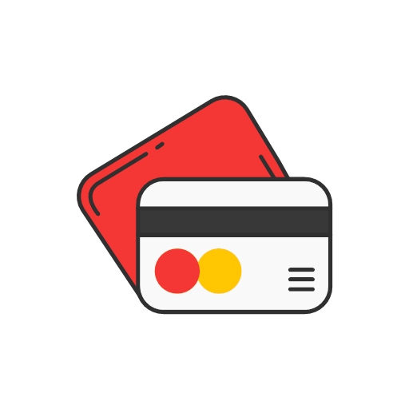
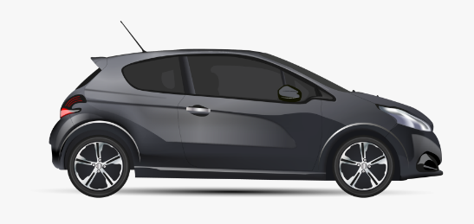
How Much is Too Much?
30% 36%
Notes:
Most experts recommend that no more than 30% of your gross monthly income be used to pay for your housing expenses (including mortgage or rent, taxes and insurance).
They also recommend that your total debt to income ratio be no more than 36% when paying all of your recurring debt.

Slide 7
Debt-to-Income Ratio
Debt-to-income ratios look at how much you owe in comparison to how much you earn
It usually gives a good picture of your financial well being
The lower your debt-to-income ratio, the more money you have to spend on things other than your monthly bills
Notes:
A good way to figure out if you’ve taken on too much debt is to look at your debt-to-income ratio. Your debt-to-income ratio will tell you what percentage of your monthly income is going toward debt payments.

Slide 8
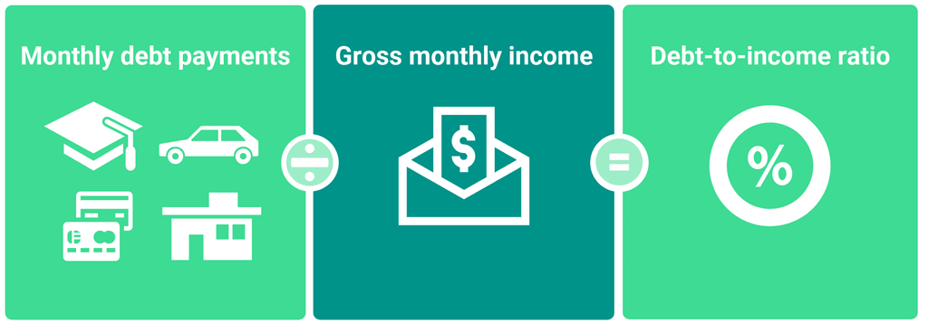
Debt-to-Income Ratio Calculation
Example:
Notes:
So we want to calculate that debt-to-income to find out where we stand with all our debt! To calculate your debt-to-income ratio, you need to do a little work on confirming your Gross Monthly Income (this is what you are paid before taxes are taken out). You also have to gather all your monthly debt payments. All monthly obligations such as loans, credit cards, and your mortgage or rent plus tax and insurance. Add the total of all you monthly debt payments and divide that amount by our gross monthly income. This quick example would be, adding up all debt of a house payment, taxes and insurance adds up to of $800 a month, plus a payment of $300, and two credit card payments of $100. Monthly debt payments equal $1,200. We divide this by $3,500 (the monthly gross income of an individual who makes 42 thousand a year) this equals .34 or Debt-to-Income Ratio of 34%

Slide 9
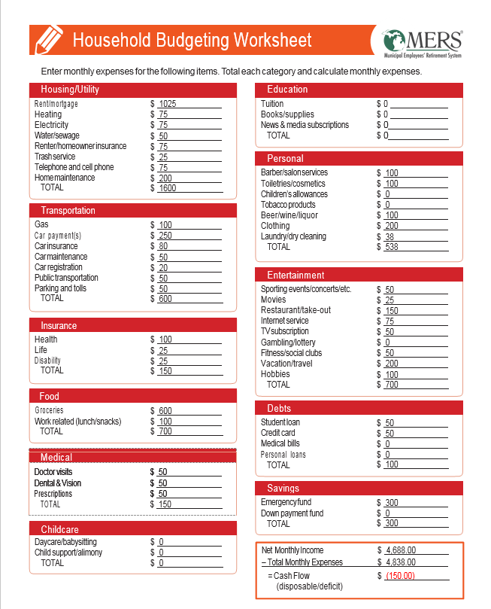
Complete a Household Budgeting Worksheet
Parent / Financial Educator Tip:
Teaching budgeting concepts at a young age can help children develop healthy financial habits. A simple budgeting worksheet is a great tool to help them save for bigger purchases like a bike or video game.
Notes:
Using a tool such as a Household Budgeting Worksheet can help you determine your monthly income and expenses. There are many different options available online, or you can find one in the Financial Goals Workbook.

Slide 10
Understanding the Impacts of Good and Bad Credit
Notes:
Now that you know a little more about how to determine your debts and income, let’s talk about the effect that debt and credit can have on your everyday life

Slide 11
What is Credit?
Credit is when goods, services or money is received in exchange for a promise to pay a definite sum of money at a future date.
Notes:
First – let’s define what credit is. Credit is when goods, services, or money is received in exchange for a promise to pay a definite sum of money at a future date. Your credit is measured by a score issued by FICO

Slide 12
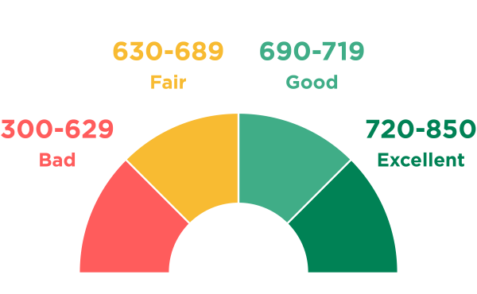
Credit Scores
Parent / Financial Educator Tip:
Help children understand the concept of a credit score by relating it to the grading system in school. The higher the score, the better.
Notes:
A credit score is a prediction of how likely you are to pay your bills. Your score is a number between 300 and 850 and it’s derived from many different factors such as length of credit history, amount of revolving debt, number of open accounts and payment history.
As you can see from the chart here, the higher your score, the better. We’ll talk about how those high and low scores can impact your purchasing power in just a minute.

Slide 13
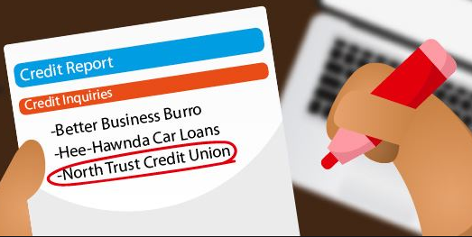
Free Credit Report Available Annually
Website to request your free report: www.annualcreditreport.com
Check for mistakes!
Parent / Financial Educator Tip:
Consider sharing a sample credit report with your child so they understand what information and value it provides.
Notes:
Per federal law you are entitled to one free credit report annually from each of the three major credit bureaus - Experian, Equifax and TransUnion. It is important that you review your credit report annually, at a minimum, to ensure that there are no mistakes or cases of identify fraud on your report. One in every five American consumers has an error on their report, so it’s fairly common and it could be hurting your overall credit score or costing you money in unnecessary fees.
https://www.consumerfinance.gov/about-us/blog/common-errors-credit-report-and-how-get-them-fixed/

Slide 14
Who Cares About Your Credit?
Creditors/Lenders
Insurance Companies
Landlords
Employers
Utility Companies
Government Agencies
YOU!
Notes:
If you’re wondering why a good credit score is so important to maintain, it’s because your credit follows you around through almost every aspect of your life. Your credit score is checked before you can get any type of loan, and the better your score, the more likely you are to get a better interest rate. Your score can affect the amount you pay for car insurance, whether or not you can secure rental housing, your ability to get utilities or a cell phone, and yes, even some employers require a credit check before they will hire you.
The reason behind these checks is simple – a higher score is associated with responsibility. It is perceived to mean that you are more likely to pay your bills on time and be a good employee. Let’s talk a little more about the effects of good and bad credit.

Slide 15
Effects of Having Bad Credit
Denial of credit card or loan applications
Higher interest rates on loans and credit cards
Difficulty securing rental housing, utilities and a cell phone
Denial of employment
Higher auto insurance costs
Less purchasing power
Stress and anxiety due to an unfavorable financial situation
Notes:
https://www.thebalance.com/reasons-debt-is-bad-960048

Slide 16
Benefits of Having Good Credit
Better chance of approval for credits cards and loans and lower interest rates when approved
More negotiating power when financing large purchases
Likely to get approval for higher limits
Easier approval for rental housing
Easier to purchase or secure things like a cell phone and utilities without a security deposit
Parent / Financial Educator Tip:
Consider helping your older teenage children build good credit by co-signing for a credit card that has a low spending limit. Monitor usage to ensure that it is used responsibly and paid off monthly.
Notes:
https://www.thebalance.com/having-good-credit-score-960528

Slide 17
When to Take Action & Debt Management Strategies
Notes:
Have you ever had trouble falling asleep at night because you’re worried about money? Or do you struggle to make more than the minimum payment each month on your credit card bills? These are signs that you may have taken on a bit too much debt. And that’s what we’re going to address in this next section.

Slide 18
Signs Your Debt is Becoming a Problem
Lost sleep
Problematic credit score
Carrying a credit card balance
Spending money for interest and late fees
Not able to save for future purchases
Increase in money arguments with partner
Only making minimum payments each month
Late payment penalties
Using your credit card to pay regular expenses (groceries, gas, etc.)
Total debt payments exceeds 36% of take home pay
Notes:
Signs that you could be in over your head with debt include:
Lost sleep
Problematic credit score
Carrying a credit card balance
Spending money for interest and late fees
Not able to save for future purchases
Increase in money arguments with partner
You can only make the minimum payment each month
You have late payment penalties
You are using your credit card to pay regular expenses (groceries, gas, etc.)
Your total debt payments exceeds 36% of your take home pay (including your home mortgage)
If you’re experiencing one or more of these symptoms, you likely need to take action to manage your debt.

Slide 19
Debt Management
Debt management is simply creating a plan to repay debt in a meaningful way.
Before implementing a debt management strategy,
freeze all credit card spending.
Notes:
Debt management is simply creating a plan to repay debt in a meaningful way.
And the number one way to kick off your debt management strategy is to immediacy cease all credit card spending. This will help you to stay on track and complete your goals within your desired timeline.

Slide 20
Debt Management Strategies
Single Card Payoff
Multiple Card Payoff
Debt Consolidation
Notes:
Today we’re going to review four possible debt management strategies:
1. A strategy to address paying off your credit card if you have one card you owe money on
2. A strategy to address paying off multiple cards
3. Debt consolidation options
4. And finally, we’ll talk about debt settlement options

Slide 21
Single Card Payoff
1
Did you know?
Paying even just $25 over your minimum monthly payment can have a big impact on the time it takes you to pay off your credit card bill.
Example:
Joe has $4,000 in credit card debt with a 15% interest rate
Monthly Payment | Time to Pay Off Card (if no additional purchases made) | Total Interest Paid
First Payment of $120, then Minimum Payment (3% of balance or $25 whichever is greater) | Over 11 years | $2,513
$145 | 2 years 6 months | $935
$220 | 1 year 9 months | $566
Notes:
No matter, which strategy you choose – paying more than your minimum payment has a huge impact.
And this single card example will show us that. Here’s an example of the impact of paying more than your monthly payment on your credit card debt when you only have one card to deal with.
Now, this example should look familiar to those that see a credit card statement. The Credit Card ACT of 2009 forced the credit card companies to put something similar on the statements but lets dive in. this slide points out that paying more than your minimum payment can make an impact on the balance, even if it’s a small amount it can have a big impact.
Joe owes $4,000 on a credit card with a 15% interest rate. If Joe pays the monthly minimum payment of $120, and continues to pay the monthly minimum payment, even as that balance goes down, it will take him over 13 years to pay off his card, AND he will pay an additional $2,513 in interest.
If Joe puts just an extra $25/month towards his payment, and continues to pay that amount for the remainder of the balance, he can pay off the credit card in less than three years. In this case he will pay $935 in interest rather than the $2,650.
Lets take it up a notch, If Joe could find more money in his budget and pays $220/month for the remainder of the balance, he will pay off his credit card in less than 2 years while paying a much smaller amount of $566 in interest.

Slide 22
Snowball Method
2
Smallest Debt
Bigger Debt
Biggest Debt
Notes:
If you have multiple debts or credit cards. Paying off your debt using the snowball method focuses first on your smallest balance. The idea is simple:
List your debts from smallest balance to largest balance. Pay as much as you can towards the smallest and make minimum payments on everything else.
Once the smallest debt is paid off, keep working your way down the list until you’re debt-free.
Because having multiple debts can seem overwhelming, this is a good option to help prioritize debts that are easiest to pay off before moving to larger bills that will take more time to address.

Slide 23
Avalanche Method
3
Highest Interest Rate
% % %
Next Highest Interest Rate
% %
Lowest Interest Rate
%
Notes:
The debt avalanche method focuses on paying off debt with the highest interest rate first, and then moving towards paying off debt with lower interest rates. The idea is straightforward:
List your debts from highest interest rate to smallest interest rate. Pay as much as you can toward the debt with the highest interest rate. Again, always make your minimum payments on the rest.
This method works because:
Mathematically it makes the most sense.
You’ll pay less in interest if you tackle your debts using this method.
And what does saving money on interest mean? You’ll become debt-free faster. (Usually by a few weeks or a couple of months).
So for some people, this makes the most since mathematically and for others the Snowball Method is motivating because it eliminates the number of debts the quickest. What do you Choose, well, You choose what works best for you and what is going to motivate you up to the finish line!

Slide 24
Debt Consolidation
4
Plans involve combining debts into one loan in an attempt to lower monthly payments and interest charges
Can make a lot of sense for people with a high level of debt or paying multiple bills
National Debt Relief: www.nationaldebtrelief.com
Notes:
If you have more loan payments that you can handle, or each separate payment is getting harder and harder to pay each month, you may want to consider debt consolidation - combining debts into one loan can potentially lower monthly payments and interest charges.
Debt Consolidation involves combining debts into one loan in an attempt to lower monthly payments and interest charges.
National Debt Relief is one organization that does this, and was rated #1 by consumer reviews.

Slide 25
Debt & Credit Tips
Do not take on any new debts, if possible
If you need to take on a loan or other type of debt, read the fine print carefully and try to negotiate the lowest interest rate possible
Don’t wait too long before getting help if you are experiencing problems dealing with your debt payments
Have a plan in place to pay your bills on time, in full, every month
Stick to your plan!

Slide 26
Building a Better Budget Updated January 2022
Notes:
Welcome to this “Building a Better Budget” webinar. My name is Leah Behnke, I am a MERS Benefit Plan Advisor, and I will be your presenter today. Joining me to help answer your questions is Angie Schrauben, a Benefit Education Specialist here at MERS. Hi Angie!

Slide 27
Agenda
Purpose of a Budget
Building Your Budget
Identifying and Addressing Budget Gaps
Budgeting Tools and Tips
Monitoring Your Plan and Key Action Items
Notes:
Our plan today is to start out discussing why we even spend time budgeting, how to build that budget and how to figure out our problem area.
Then we will share some tips and ideas we have for the budget and end with the importance of monitoring and readjusting your plan.
If anyone would like to add any questions or burning topics that they expected to see, and don’t, please feel free to share in the questions tab now or as we go through the webinar.

Slide 28
“Beware of little
expenses;
a small leak will sink a
great ship.”
-Benjamin Franklin
Notes:
I’m going to make the assumption that, if you’ve joined this session today, you have a goal to improve your finances and better understand where your money is going.
If so, you are in the right place! Having a financial plan is a must for anyone who hopes to achieve any sort of financial goal in the future, and the first step to creating your plan is to understand your sources of income and expenses, and creating a budget.

Slide 29
Purpose of a Budget
Notes:
I am going to start by sharing the relationship I have with my budget - many years I so called “budgeted” or more or less tracked spending after the fact. Then I came to a point in my life I wanted to set some financial goals and Actually met them.
That’s when I realized how badly I need to expand my budgeting skills, I did a lot of work and made that happen and had to adjust over the years to make sure I kept at it through my busy life. But I am happy to say I met some pretty lofty goals, expanded with more goals, rested a bit but continued to stay true to budgeting! IT became my accountability and sensibility when considering new purchases AND at times, it’s been my partner in crime because I build in those items I want and save for them. Its never been easy but I can say it seems I always have more money to go around when budgeting… it definitely gives me back control of my money!
And let me say one last thing about my personal journey, It all started with written goals. The fact that I wrote down a specific goal and worked at it each and every day.

Slide 30
Budget Benefits
A budget can:
Provide guidance and direction
Facilitate planning
Motivate and inspire action
Help evaluate progress
MERS of Michigan | 30
Notes:
There’s a reason we create a budget, and it’s not just to make more work for ourselves.
When you’re establishing a budget, one of the first things you need to do is identify your why, who you doing this for and what are your finical goals! Without clearly identified goals and a supportive plan, there’s the tendency to mismanage your money with the potential for financial trouble. Each goal should have a time horizon and can be a stepping stone for a future goal.
SO its your turn, I want you to Think about your goals. Maybe you have a goal in mind, maybe you have a why in mind, maybe its to get out of debt or just learn how to budget.
Please do this for yourself, take a moment to write down a few words that you want to focus on when it comes to finance, budgeting, debt, its up to you. (you can share in the comments, if you would like)
You can build on these words later and define your Financial Goal, There is actually a Goals page in the Worksheet provided. BUT Ultimately Goals are the building block for the foundation for your overall financial plan. And to get there we have to start with the budget.

Slide 31
Building a Budget
A good budget will help you to compare your income to your debts and expenses.
Income
Expenses
Debts
Notes:
A good budget will help you to compare your income to your debts and expenses.
Income
Income is the sum of all wages, salaries, profits, and other earnings received by a person or a household.
Expenses
Simply includes all of the money that goes out to pay for goods and services. Your regular monthly expenses and occasional/seasonal expenses.
Debts
Debts include the money that you owe and need to repay.

Slide 32
Building Your Budget
Notes:
So now we know more about the benefits of having a budget and what we need to include in one. You also know my relationship with budgeting. Now we want to know why you are here. We’ll launch a poll to get an idea of why your joining us today.
Read Poll… give time

Slide 33
Complete a Household Budgeting Worksheet
Compare
EXPENSES vs INCOME
Notes:
This Household Budgeting Worksheet is in the Financial Planning Workbook provided. The first building block is to look at what you currently earn and spend. This is a good step for all of us, regardless of income.
Did you know that many people with salaries above $100,000 feel broke much of the time? A person can earn a lot of money and still feel financially insecure. On the other hand, many people who earn $30,000 or less feel that they’re doing well financially.
Financial security doesn’t depend on how much you earn. Instead, financial security is determined by how much you accumulate after paying those expenses — and how you manage what you keep.
Using a tool such as the Household Budgeting Worksheet can help you capture all of these expenses in one place. This sheet may remind you of some other things you weren’t thinking about so you can truly get a holistic view of your expenses. This is an important step before you move forward with any financial goal.

Slide 34
Sources to Consider
Savings
Pension
Supplement savings account (457)
401(k)/401(a)
IRA
Stocks and Bonds
Emergency fund
Income
Current salary
Income from rentals
Side jobs
Notes:
When it comes to capturing your income, include all of your savings and income sources. . Consider your savings accounts, including retirement, investment and bank accounts.
For Income, there’s not only your income to consider but spouses' salaries and income from any rental units or side jobs you have.
As with all parts of the budget, it is important to continually monitor and update your plan in case the circumstances change.

Slide 35
Sources to Consider, cont’d
Expenses
Housing (mortgage)
Transportation (gas, auto loans, insurance)
Insurance/Healthcare
Food
Miscellaneous
Personal care
Clothing
Hobbies
Travel
Debts
Student loans
Credit cards
Medical bills
Loans
MERS of Michigan | 35
Notes:
Next you’ll want to think about your expenses such as your mortgage and food. Include all of the monthly payments such as credit cards and student loans and don’t forget about those quarterly or annual payments that you may have.

Slide 36
Identify Your Gaps
Notes:
Now that we have the budgeting down we can start to identify the gaps.

Slide 37
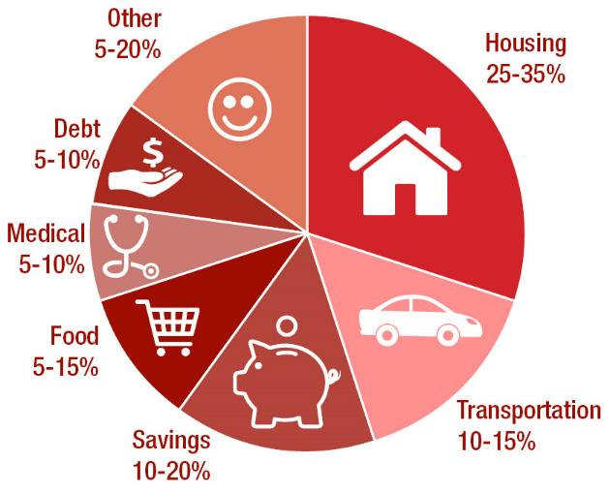
Average Household Expense Ranges
Source: US Bureau of Labor Statistics Consumer Expenditure Survey
*
* Includes emergency fund savings, retirement savings, etc.
Notes:
Now, one of the most difficult things to do when setting up a family (or an individual’s) budget for the first time is to try and figure out how much you should spend in each category.
The whole purpose of a budget is to set you straight on your spending habits and bring them back into line, right?
Well, where do you look?
First you could look at the national averages - to get an idea of where you might want to be.
Remember every family and individual is unique and different – there is no perfect combination and your goals may be eliminate debt or save a larger amount than the national average. Either way, this is solely a guide explaining what the national averages are and what we will use for our example

Slide 38
Example: Meet Sandy
Sandy would like to establish a budget and set some spending goals for herself
Sandy’s net monthly income is $4,688 ($56,256 annually)
She is single with no children
Notes:
Here is that example. Meet Sandy. She’s new to this whole budgeting thing so we are going to help Sandy identify her financial gaps, if she has any.
At this point Sandy would like to establish a budget and set some spending goals for her self.
For the purpose of this example, we will say that Sandy’s net monthly income is $4,688.
She lives alone and has no dependents to support.

Slide 39
Determining Sandy’s Gaps
Budgeted Expense | Sandy’s Goal | Determining Target Amount (Sandy’s monthly net income x goal) | Target Monthly Amount
Housing (25 – 35%) | % |  | $
Transportation (10 – 15%) | % |  | $
Savings (10 – 20%) | % |  | $
Food (5 – 15%) | % |  | $
Medical (5 – 10%) | % |  | $
Debt Payments (5 – 10%) | % |  | $
All Other (5 -20%) | % |  | $
35
$4,688 x 35%
1,641
10
$4,688 x 10%
469
15
$4,688 x 15%
703
10
$4,688 x 10%
469
5
$4,688 x 5%
234
5
$4,688 x 5%
234
20
$4,688 x 20%
938
Notes:
Now Sandy already gathered her income and expenses in the worksheet to determine where her money is going and coming from. And she wants to compare her spending to the National Averages found on the proceeding slide. This is where we get the Percentages on this slide. And we are walking through this exercise to find where her gaps are. But first, this is how she determines what her recommended dollar amount for each category should be.
To calculate the dollar amount to spend in each category, we multiply the net income by the targeted goal. For example, Sandy’s net income is $4,688 and her target for housing is 35%. Sandy does that math to see that her recommended housing costs should be no more than $1,641 per month.

Slide 40
Determining Sandy’s Gaps, cont’d
Budgeted Expense | Sandy’s Goals | Target Monthly Amount (Sandy’s monthly net income x goal) | Actual Monthly Amount Spent | Area of Concern?
Housing (25 – 35%) | 35% | $1,641 | $1,600
Transportation (10 – 15%) | 10% | $469 | $400
Savings (10 – 20%) | 15% | $703 | $300 | Yes
Food (5 – 15%) | 10% | $469 | $700 | Yes
Medical (5 – 10%) | 5% | $234 | $150
Debt Payments (5 – 10%) | 5% | $234 | $100
All Other (5 -20%) | 20% | $938 | $1,238 | Yes
Notes:
After completing this calculation for all categories, Sandy comes to some realizations.

Slide 41
Analysis
Based on this analysis, Sandy should take the following steps to adjust her monthly budget:
Reduce her food and miscellaneous monthly expenses
Consider increasing the amount she is setting aside for savings
Where are
your gaps?
Notes:
In Sandy’s case based on the gaps in her budget - her results may look like this
She needs to cut back on the cost of food and miscellaneous expenses. AND she needs to save more!
In your workbook, you’ll find the budgeting expense worksheet to figure out where your opportunities for adjustment are.

Slide 42
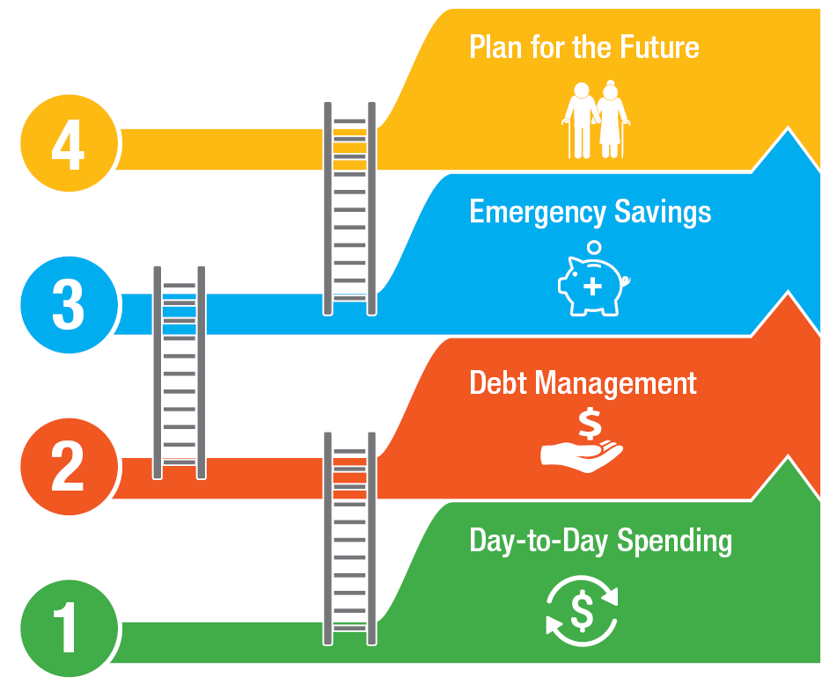
Notes:
There are a lot of places Sandy can start to make some changes. This graphic is a good rule of thumb to help prioritize spending and savings actions.
The first is to address day-to-day spending and ensuring that you are spending “within your means. ”
When that’s under control, you then want to work on a plan to manage your debt.
Once you have a budget, and your debt is under control, you can begin building your emergency savings fund.
Finally, once you’ve addressed those three key areas, you can begin to plan for the future.
No I am going to put you to work with a quiz, don’t fret, its just one question and I wont even say who's wrong. So we will launch that Poll…
Read Poll… Give time
Well I don’t want to rain on this budgeting parade but I have had questions come up from this very slide asking, shouldn’t emergency saving come first!
Based on this survey and my thoughts, if you don’t have 500 to 1000 in your account that should be a priority to work that in your budget right away, because emergency will happen! And a little savings each week can go a long way.
I also want to share that during the virtual conference, we do have webinars scheduled to focusing on emergency savings and debt management. You can visit the conference website to register to attend, or they will be available to view on our website after the conference is over.

Slide 43
Budgeting Tools and Tips
Notes:
Now we are going to jump into the Budgeting Tools and Tips.

Slide 44
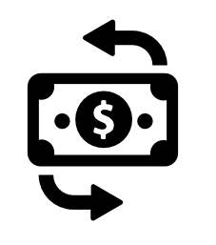
Manage Your Day-to-Day Spending
To spend “within your means” is to spend less than or equal to the amount of money you bring in
The first step is to know your income and expenses. You can do this by creating a budget
Budgeting is a tool that tells your money where to go ahead of time versus wondering where it all went after you spent it
Notes:
To spend “within your means” means that what you send is less than or equal to the amount of money you bring in
As a nation, we love to buy, but sometimes that consumerism leads to debt and monthly financial struggles. The first step is to know your income and expenses, in other words, what is coming in and what is going out.
Budgeting is a tool that tells your money where to go ahead of time vs. wondering where it all went after you spend it. 68% of Americans don’t budget every month for a number of reasons.
Many people are intimidated or think they don’t have time to work on a budget.
However advances in technology are making it easier than ever for people to track their day-to-day expenses in one convenient location. Budgeting can be looked at as the first step to financial wellness. It is the plan or the strategy to get you where you want to be.

Slide 45
Budgeting Tools
Online tools through your bank
Microsoft Office templates
Organizations such as:
National Credit Union Administration (mycreditunion.gov)
Visa (practicalmoneyskills.com)
Apps
Mint
You Need a Budget (1 month free trial subscription)
Wally
MERS Financial Fitness Dashboard
Offers customizable budgeting, savings and other interactive financial planning tools
Notes:
Online tools through your bank
Many financial institutions such as Bank of America and Lake Trust Credit Union offer online budgeting calculators and tools – and as a bonus they typically connect directly to your account to help you track spending and create a customized plan
Microsoft Office templates (using Excel or Word) are a good tool for those who are more comfortably manually entering in and tracking their expenses
1. Mint: Sounds convenient and intuitive. You can connect all your bank and credit card accounts, as well as all your monthly bills. Based on your spending habits, Mint even gives you specific advice to gain more control over your budget.
2. You Need a Budget: Sounds like a good app for getting out of debt.
You Need a Budget helps you stop living paycheck to paycheck, pay down debt. It's built around a fairly simple principle – every dollar has a job.
Although users pay a monthly fee, the service claims that with the support, tools and classes, the average user pays off $500 of debt in the first month.
3. Wally: Best app for tracking expenses and this one is FREE
free Wally app. Instead of manually logging your expenses Wally lets you simply take a photo of your receipts and logs it for you. It's a great choice if you'd like more insight into where your money is going.

Slide 46
Ideas to Reduce Expenses
Household
Shop around for a better rate on things like homeowners insurance and propane
Consider refinancing your mortgage
Improve water and energy efficiency
Notes:
How often should you shop around for a better rate on your HOI? According to the Insurance Information Institute, there are four events that should trigger you to review your policy and consider getting some new quotes:
When your policy comes up for renewal
When you've made major purchases or improvements to your home
When you’ve taken action to make your home safer (added security cameras, alarm system, etc.)
When you’ve experienced a major life change (marriage, divorce, started an at-home based business)
https://www.iii.org/article/how-often-should-i-review-my-insurance-policy
By switching to LED bulbs, you can save an average of $25 per month in electrical costs – that adds up to $300/year!
Tips to cut down on water usage:
Fix the drips!
Studies show that using your dishwasher, when full, is actually more water-efficient than washing small batches by hand
When replacing appliances such as washers and dishwashers, consider purchasing water efficient models.

Slide 47
Ideas to Reduce Expenses, cont’d
Transportation
Consider carpooling or public transportation
Shop around for a better rate on auto insurance
Keep up on routine maintenance to avoid unnecessary auto repairs
Consider a longer replacement time between vehicles to avoid car payments
Notes:
Simple steps like keeping your tires inflated, cutting back on using the air conditioning in your vehicle and reducing the amount of idling you do can save you up to $372 in fuel costs per year.

Slide 48
Ideas to Reduce Expenses, cont’d
Other Discretionary Expenses
Cancel memberships that you don’t use regularly such as gym and club grocery stores
Shop around for a better deal on television, or reduce your current package
Shop thrift stores for clothing and home goods
Make your own coffee and bring your lunch to work – doing so can save you hundreds each year!

Slide 49
Monitoring Your Plan & Key Action Items

Slide 50
Monitor Regularly
Determine how often you will revisit your goals to make sure you are still on track – at least twice a year is recommended.
Make adjustments as needed
Enjoy the benefits of achieving your goals
Notes:
Once you’ve created your goals and budget, the key is to monitor it regularly and make adjustments as needed. A budget shouldn’t always feel like a total constraint but a guide to help you accomplish your goals. When you start out with a budget its going to take some time and adjustments to fit your life.

Slide 51
Key Action Items
If you haven’t already done so, create and log in to your myMERS account
Complete the budgeting section of your Financial Planning Workbook
Identify your gaps and strategies to address them
Take advantage of additional savings opportunities such as a 457 program or IRA
Visit www.mersofmich.com for additional retirement tools and resources
Follow “MERS of Michigan” on Facebook for news and financial tips

Slide 52
MERS Resources
Notes:
Now that we’ve discussed why we save for retirement—to have enough set aside to pay ourselves a retirement paycheck that covers what social security does not. But, how do you calculate your specific situation in a way that provides the same time of information and options that we’ve discussed here today?

Slide 53
Financial Fitness
Notes:
Now through your myMERS online account you can bring together all of your financial information together in one place. You can use data from your bank accounts, retirement plans, credit cards, and more to help you set goals, budget, and take action toward more financial security through the new Financial Fitness tool.
By completing a series of financial-focused workouts, you can not only see how you are doing with your finances, but learn what actions you may want to take to improve your situation. These easy, intuitive exercises help you make improvements in key areas that can help you achieve your financial planning goals.

Slide 54
Connect with MERS
www.mersofmich.com
MERS of Michigan
1134 Municipal Way
Lansing, MI 48917
NEW
Live Chat
1-on-1 Appointment Scheduler
Social Media
800.767.MERS (6377)
This presentation contains a summary description of MERS benefits, policies or procedures. MERS has made every effort to ensure that the information provided is accurate and up to date. Where the publication conflicts with the relevant Plan Document, the Plan Document controls.
Notes:
Thank you for attending!

